Slide 1
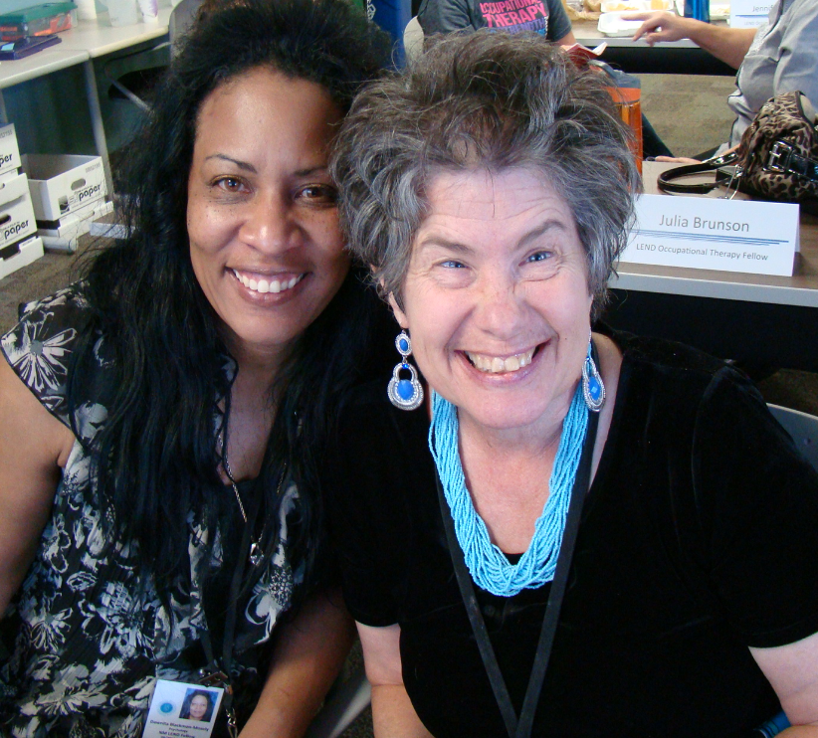
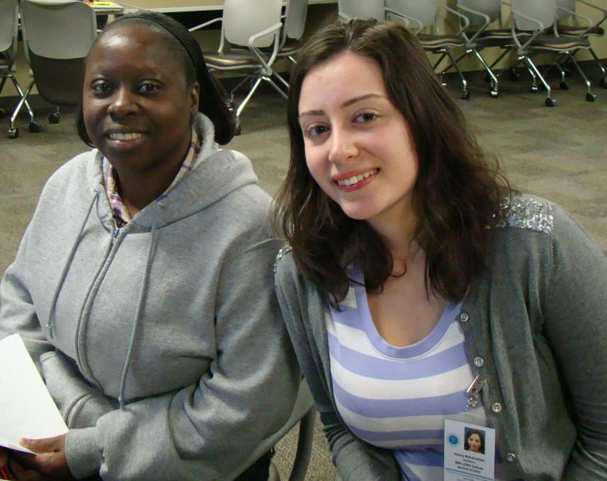
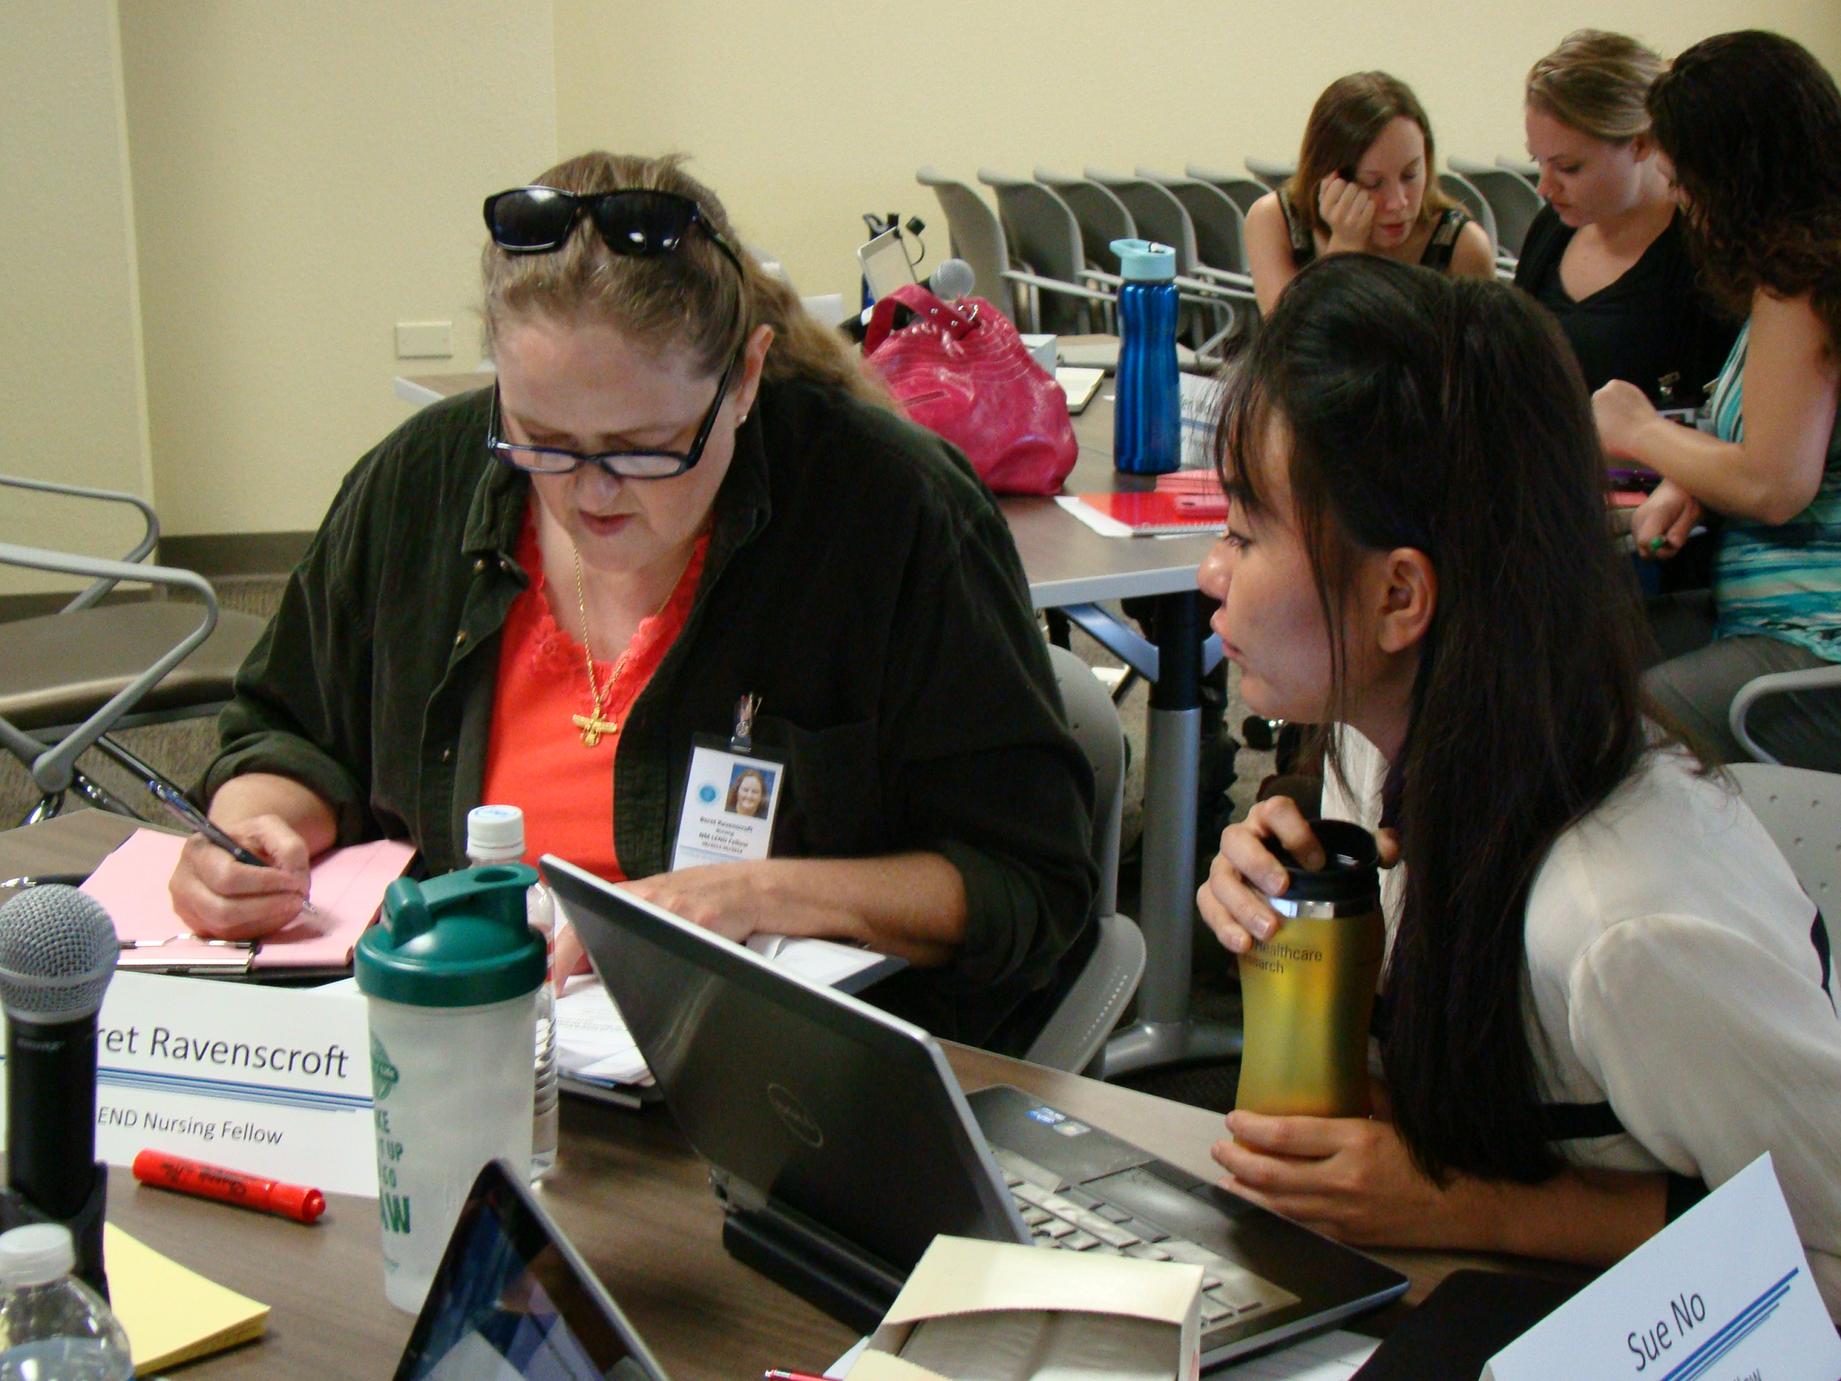
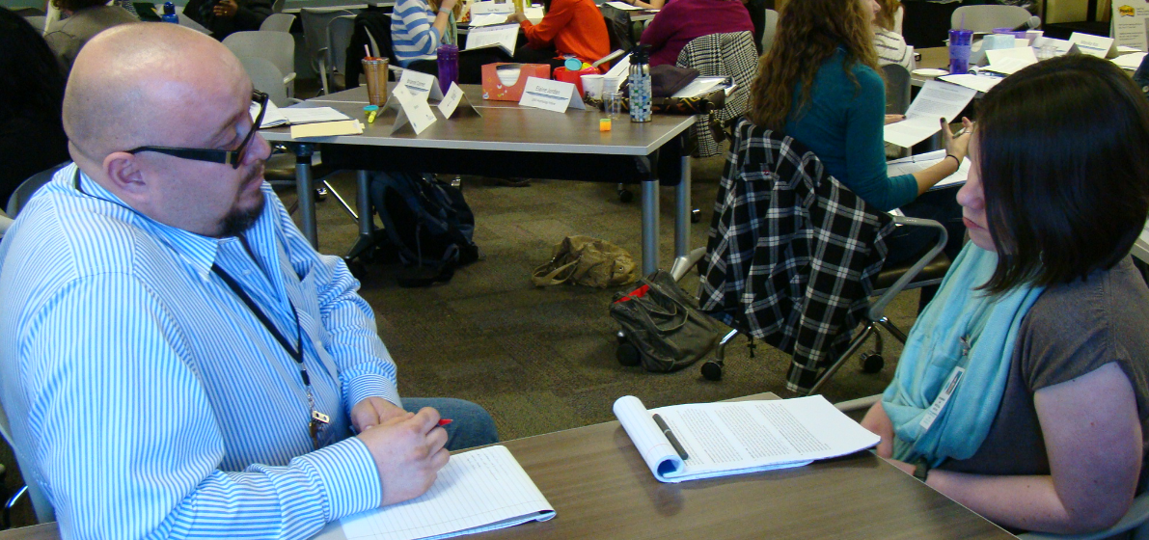
Mentoring Future Leaders: Can We Do Better?
Sandy Heimerl, NMLEND, Eileen McGrath, ArizonaLEND, Judith Holt, UTLEND, Debra Vigil, NVLEND
BACKGROUND:
Mentoring is a developmental partnership through which one person shares knowledge, skills, information, and perspectives to foster the personal and professional growth of someone else. It is incorporated into MCH Leadership Competency 9: Developing others through teaching and mentoring. Research has shown that mentorship is an effective tool for leadership development although it requires considerable commitment from the LEND faculty and trainees. To be effective, an understanding of the goals of mentoring, a clear process and an understanding of how to implement the mentorship program are required.
DESCRIPTION:
Nine PacWest LEND programs completed an on-line survey Summer 2016, including AK, AZ, CA, CO, NM, NV, OR, UT, WA.
SURVEY RESULTS (9 respondents):
Do Trainees participate in mentoring? Yes.
Is participation optional? 8 out of 9 responded that it is required.
Frequency of contact – Typically monthly with range from weekly to quarterly.
Duration of contact – 7 out of 9 responded “one academic year”
Mentor available between mentorship sessions – 7 out of 9 responded “yes”, 2 out of 9 responded “depends”.
Primary method of contact is face-to-face (9 out of 9). Other options included mail, phone and technology.
What is the Structure of mentorship session? 4 replied “formal”, 4 replied “informal”, and 1 replied “both”.
How is the mentor selected?
By Discipline – 5 responded “yes”.
By research or project interest – 3 responded “yes”.
Other: Mentor outside trainee’s discipline, Each trainee has 2 mentors – Discipline & Programmatic
NEXT STEPS FOR PACWEST:
Disseminate tools and resources
Share best practices
Implement the recommendations of the Maximizing Leadership Potential of Racial and Ethnic Minority Fellows 2014-2016 program
11. What strategies do you use when mentoring?
Regular and consistent process.
Set goals for meeting.
Self-reflection regarding the learning that is occurring in seminar, community, family match, clinics.
Faculty with extensive clinical and leadership experience support trainees in applying the learning within a broad context.
Career development – academic product.
Encourage reflection on LEND experiences and its value for future practice.
For racially and ethnically diverse trainees we utilize diverse faculty and previous trainees as mentors.
Diversity trainees have systems change projects.
For mid-career professional, mentoring is tied to current work such as developing a QI project.
For mid-career professional, emphasis on reflective practice while weaving LEND experiences into current practice setting .
Family Faculty mentor Family trainees.
Family trainees complete a systems change project .
Family trainees are supported in telling their story and reflection on how others hear and understand their experience.
9. What is the Focus of Mentoring?
Fostering Professional Growth – 9 responded “yes”.
Trainee projects – IDP – 9 responded “yes”.
Future Goals and Plans – 9 responded “yes”.
Self-Reflection – interpreting his/her experience – 6 responded “yes”.
Clinical supervision/discussion – 6 responded “yes”.
Discuss seminar content – 3 responded “yes”.
Monitoring trainee hours – 3 responded “yes”.
10. What Tools are Used?
Documentation of progress
Documentation of objectives
Journaling
Mentorship template with specific questions
Inter-disciplinary training plan
Self-reflection activities
REFERENCES:
Goode, TD & Bronehim, SM (2012). National Center for Cultural Competence. Retrieved from http://www.aucd.org/conference/detail/session_event.cfm?session_event_id=386&showday=0
Cho, C, Ramanan, R & Feldman, M. (2011). Defining the ideal qualities of mentorship. American Journal of Medicine, 124: 452-458.

